Slide 1
Activity 2: PROPERTIES AND APPLICATIOON OF 2D FOURIER TRANSFORM PART 2
Genesis Vertudez – 202003099
App Physics 157 - Computational Analysis and Modeling in Physics
Submitted to Dr. Maricor Soriano; Mx. Rene Principe Jr.

Slide 2
OBJECTIVES
Use Fourier transform to manipulate images
Convolve images with patterns to apply it to them
Convolve images with filters to improve them
Use Fourier transform to locate certain patterns in images

Slide 3
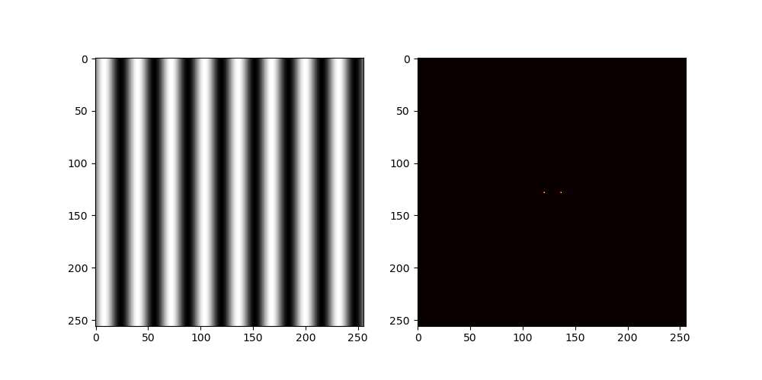

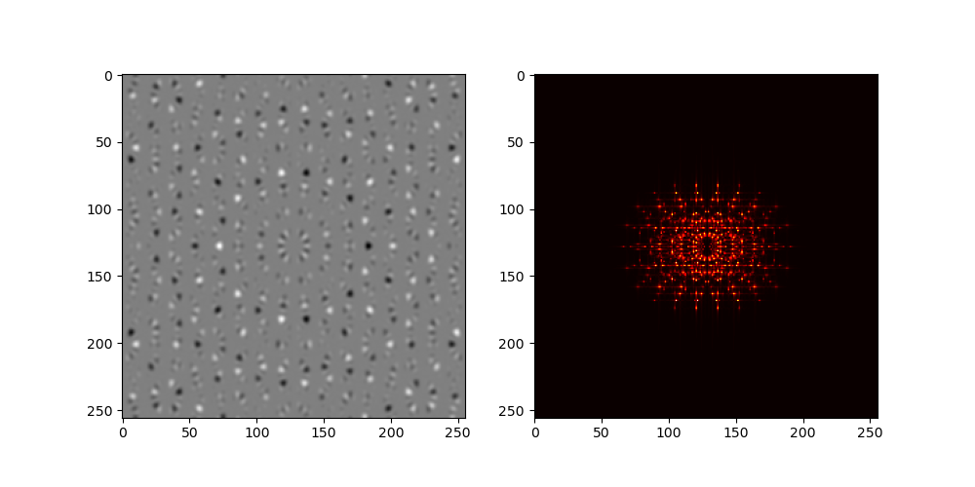
ROTATION PROPERTIES OF FT
Codes and files: https://github.com/genvert/AP_157_FX-2_Vertudez/tree/main/Activity%202%20Part%202

Slide 4
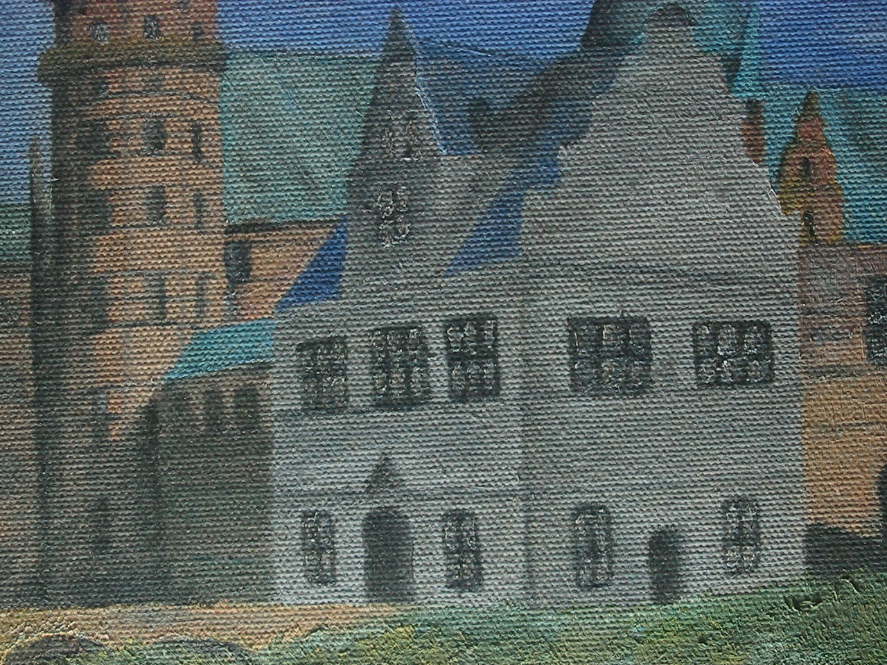
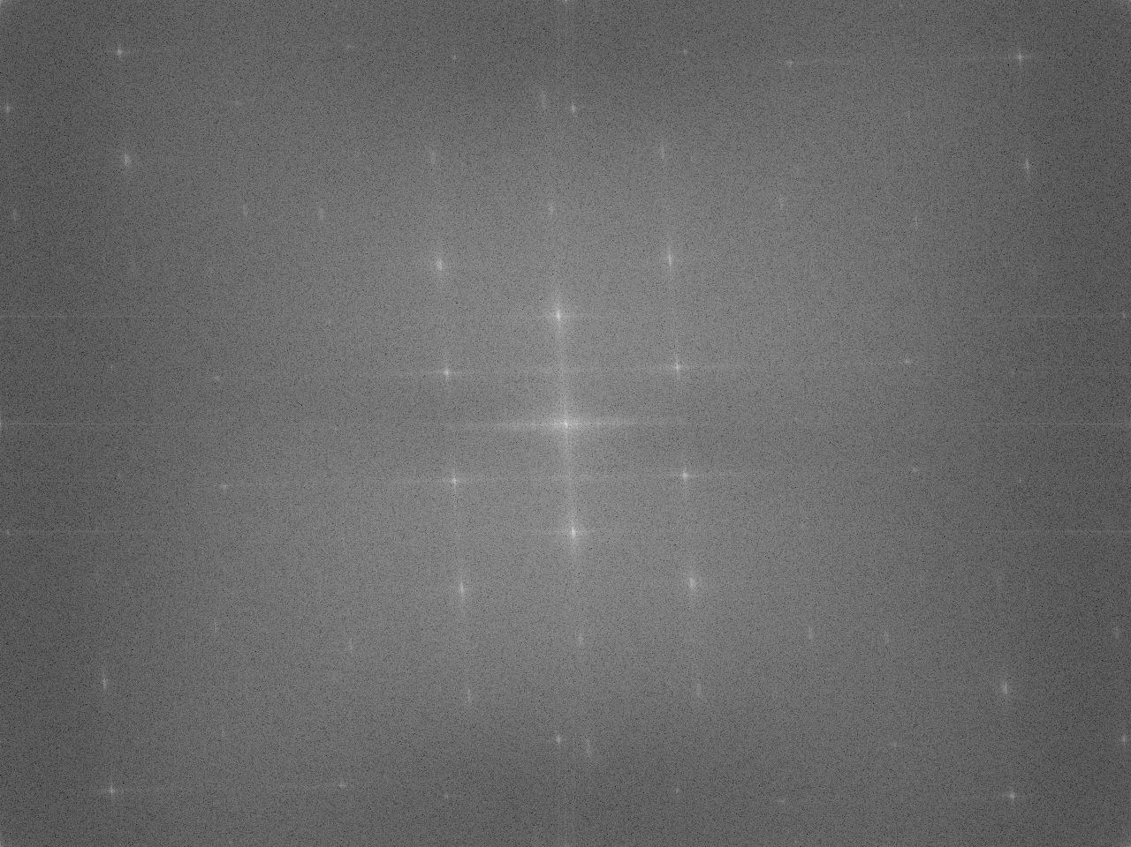




FILTERING IN FOURIER SPACE
Codes and files: https://github.com/genvert/AP_157_FX-2_Vertudez/tree/main/Activity%202%20Part%202

Slide 5
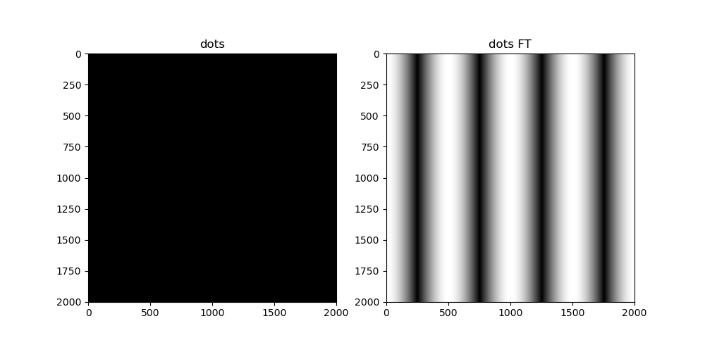
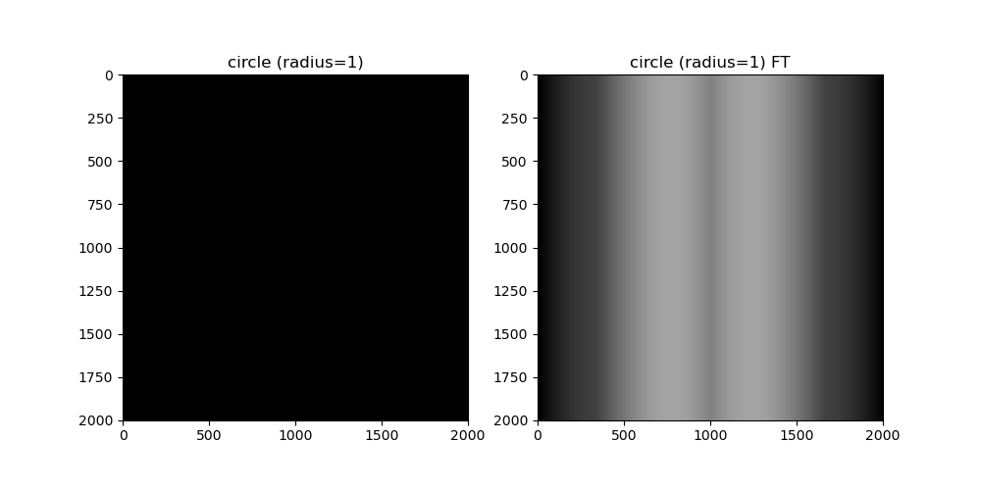
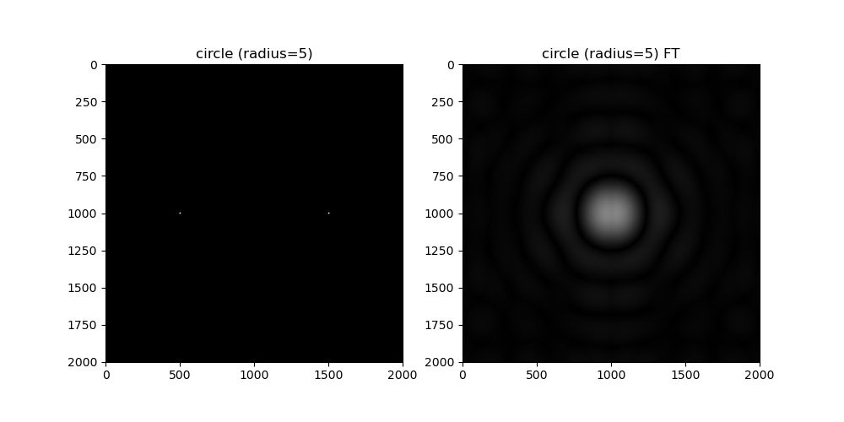
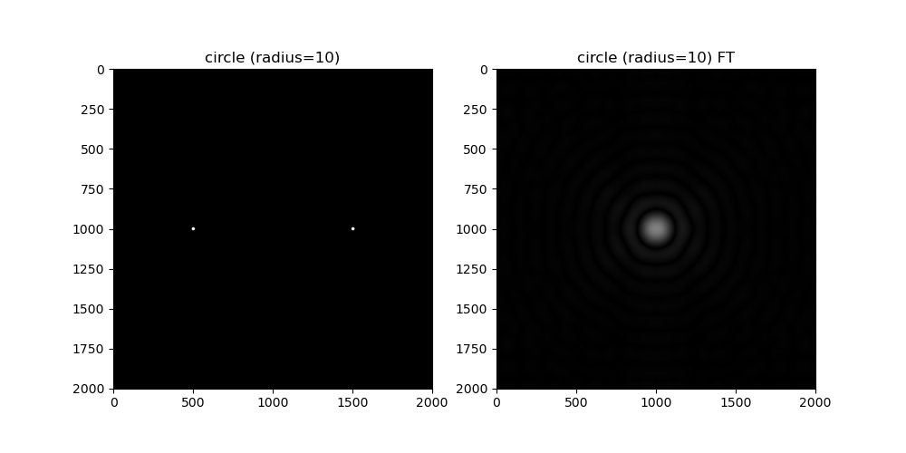
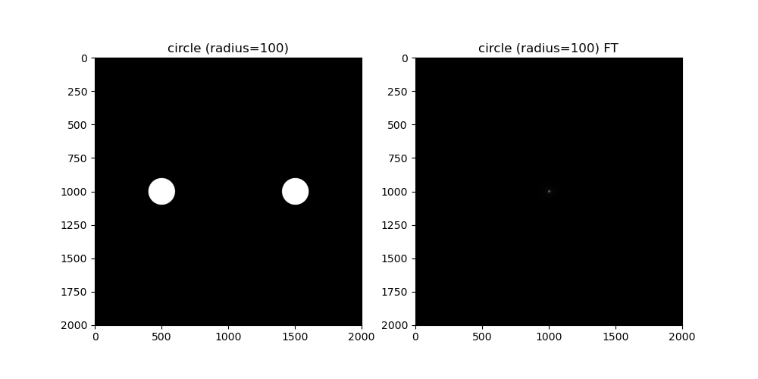
CONVOLUTION THEOREM REDUX
Codes and files: https://github.com/genvert/AP_157_FX-2_Vertudez/tree/main/Activity%202%20Part%202

Slide 6
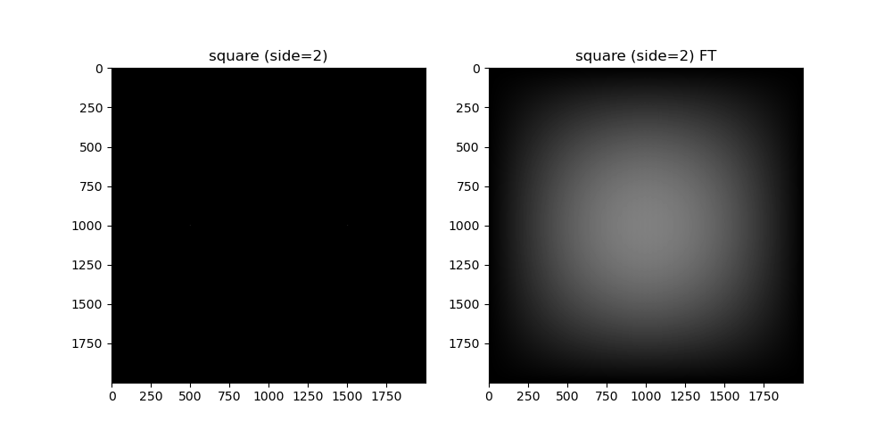
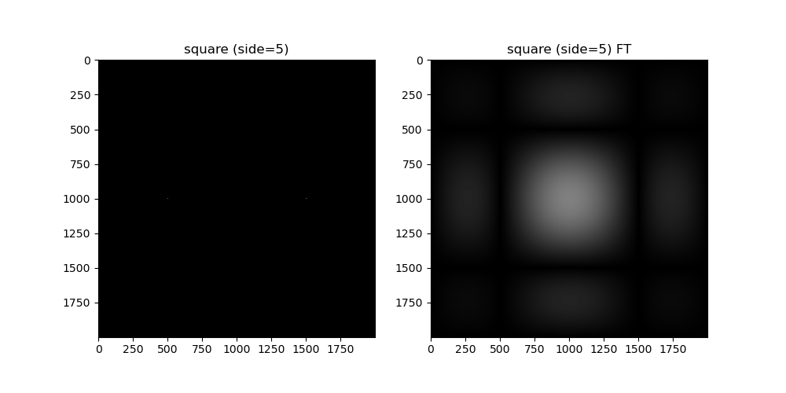
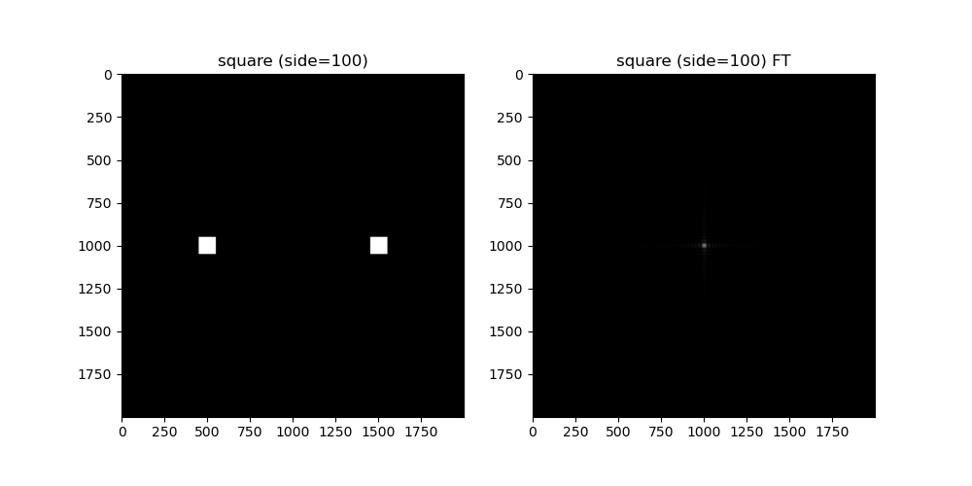
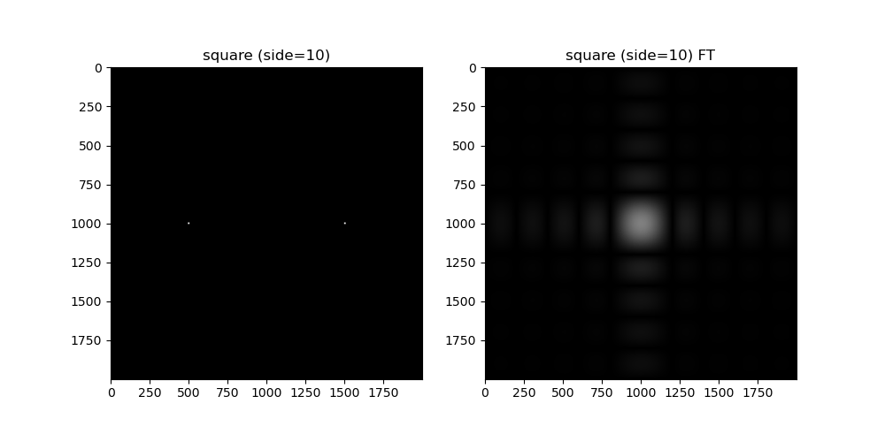
CONVOLUTION THEOREM REDUX
Codes and files: https://github.com/genvert/AP_157_FX-2_Vertudez/tree/main/Activity%202%20Part%202

Slide 7
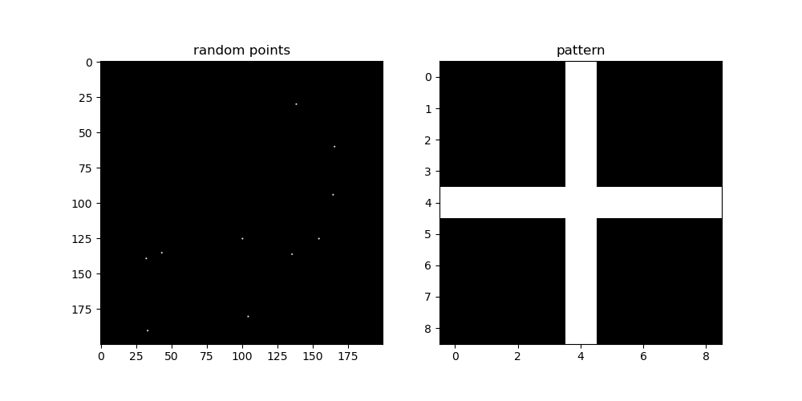
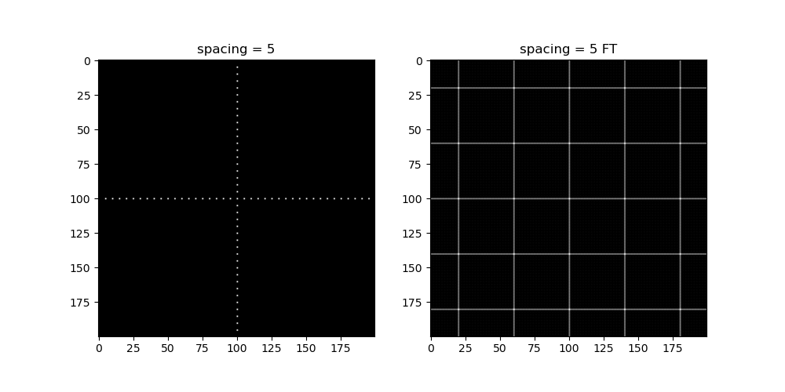

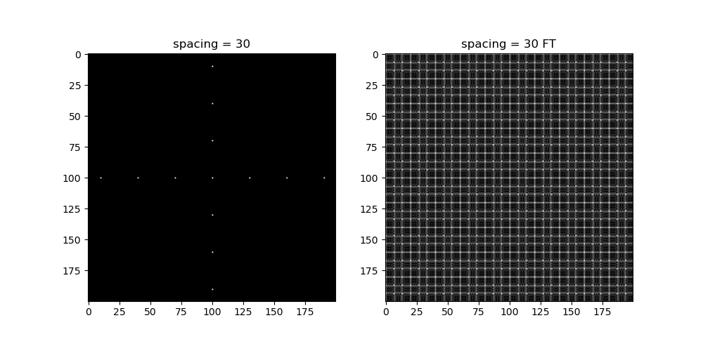
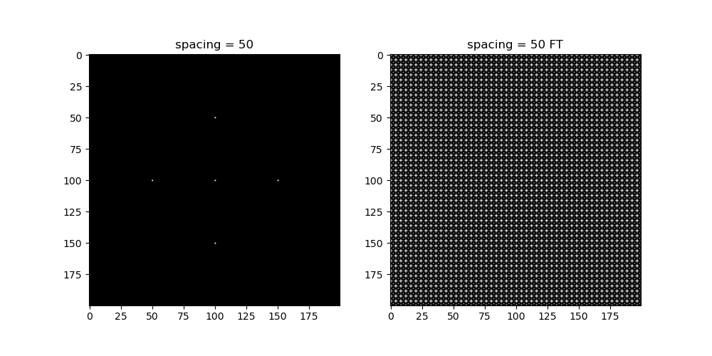
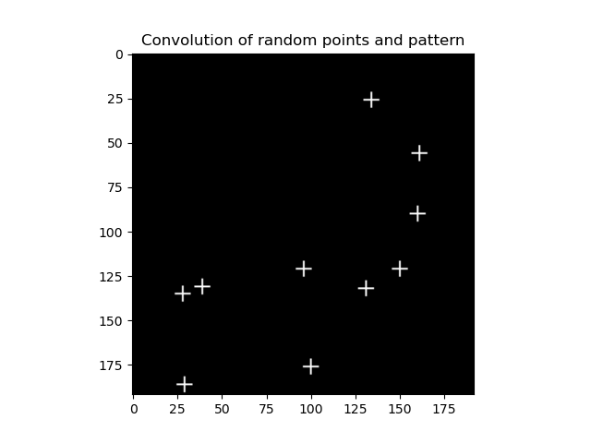
CONVOLUTION THEOREM REDUX
Codes and files: https://github.com/genvert/AP_157_FX-2_Vertudez/tree/main/Activity%202%20Part%202

Slide 8
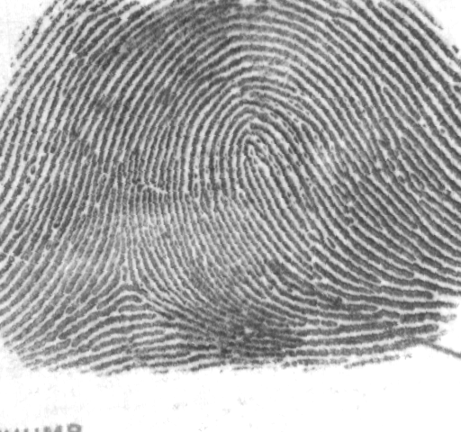

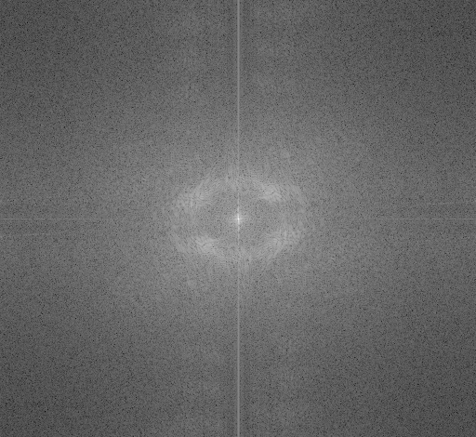
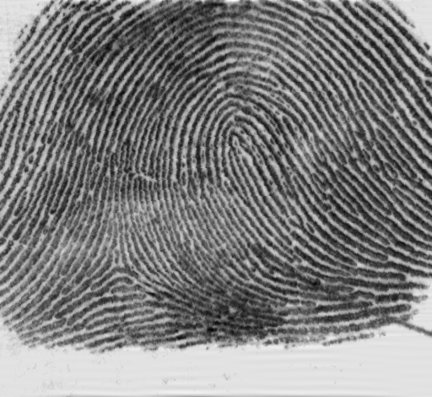
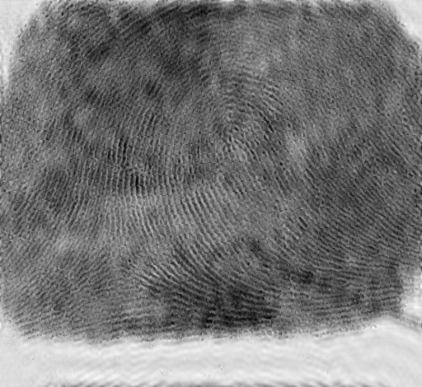

FINGERPRINT: RIDGE ENHANCEMENT
Codes and files: https://github.com/genvert/AP_157_FX-2_Vertudez/tree/main/Activity%202%20Part%202

Slide 9

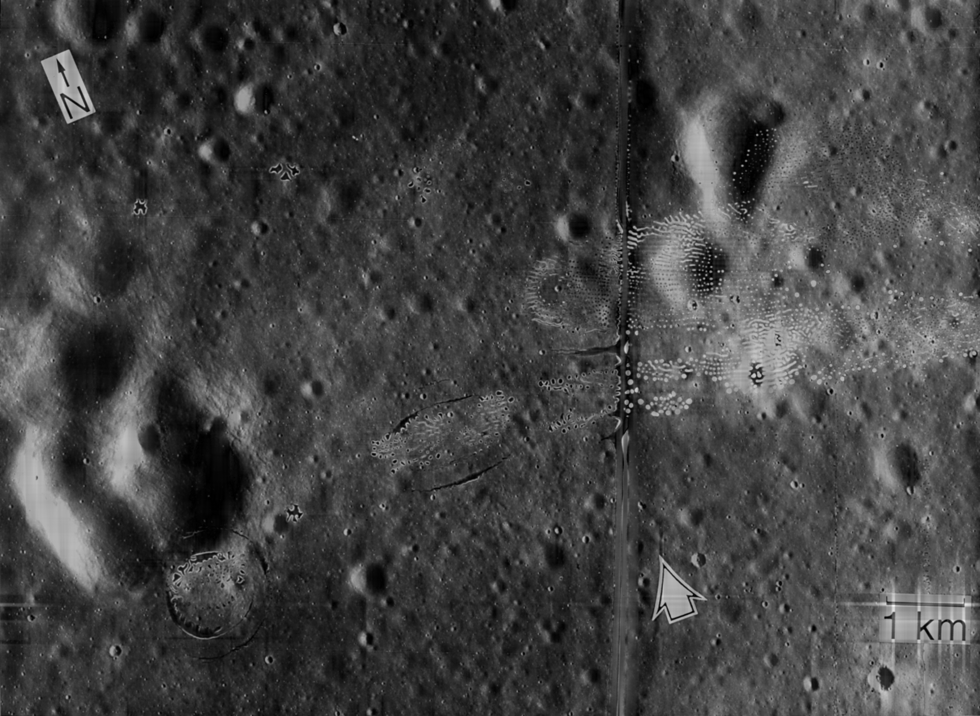

LUNAR LANDING SCANNED PICTURE: LINE REMOVAL
Codes and files: https://github.com/genvert/AP_157_FX-2_Vertudez/tree/main/Activity%202%20Part%202

Slide 10
REFLECTION
This activity was straightforward so I was able to follow it easily.
It is cool that the pixels can act as Dirac delta functions such that other images are copied to each pixel when convolved.
I managed to do it on time this time.

Slide 11
SELF-GRADE
Technical correctness: 35/35
I am confident that I understood how to use ImageJ to extract feature from images, and have applied it.
Quality of presentation: 35/35
I have explained each step, and images are clear and concise.
Self-reflection: 30/30
Even though I was slacking in this subject for a while, I managed to get back on track. The topics are really fun and interesting. It helped me understand the ideas behind image tools such as smartphone cameras, Photoshop, etc.
Initiative: 10/10
I used an extra image for extraction.

